Slide 1

Title:ONLINE ENGINEERING BOOKS MANAGEMENT
TEAM MEMBERS:
P.Naga Satya Sai(18/564)
K.Ramesh(18/5A1)
P.Pavan Sita Ram(18/580)
T.R.S.Jagan(18/5A5)
S.Ramanjaneyulu(19/511)
SWARNANDHRA COLLEGE OF ENGINEERING AND TECHNOLOGY
Project Guide:Dr.B.Rama Krishna Sir

Slide 2

ABSTRACT
“Online engineering books (learn to earn)” is an online based web portal which provides free access to all 8 semesters engineering books of all the main engineering streams. The students or the faculties can access this portal and get free access to the books for improving their knowledge.
Our main target is to avoid unemployment of engineering students if they have good knowledge and no arrears so that they can be placed in a good company and can contribute to the development of nation

Slide 3
METHODOLOGY
This online web based tool can be accessed on demand via internet.
There is a registration for enrolling users once they registered they can access their branch books.
Once user is successfully logged in he can access to all books online or if he wants a hard copy of a book he can also purchase them.
The students can access calculator, aptitude books for placement and we embedded an IDE for coding of computer science students for hands on practice.

Slide 4
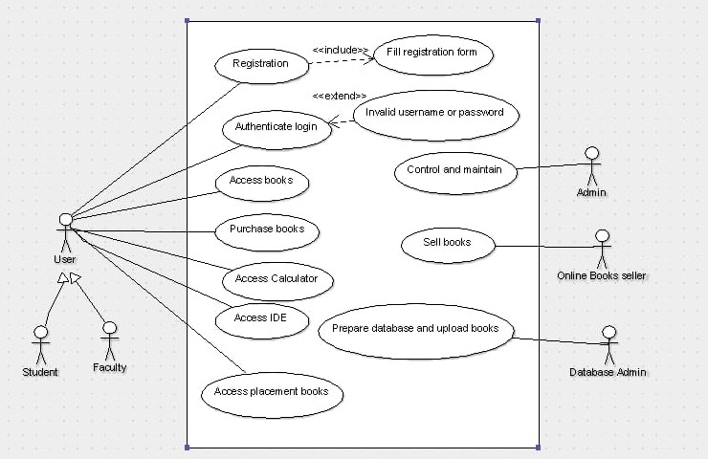
SYSTEM DESIGN
USECASE DIAGRAM:

Slide 5
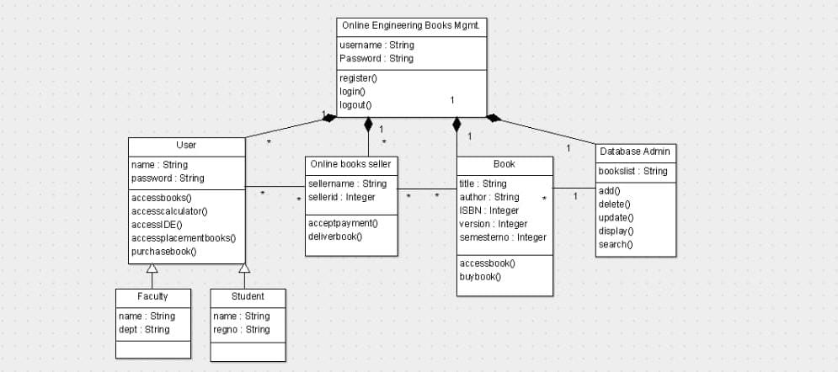
CLASS DIAGRAM:

Slide 6
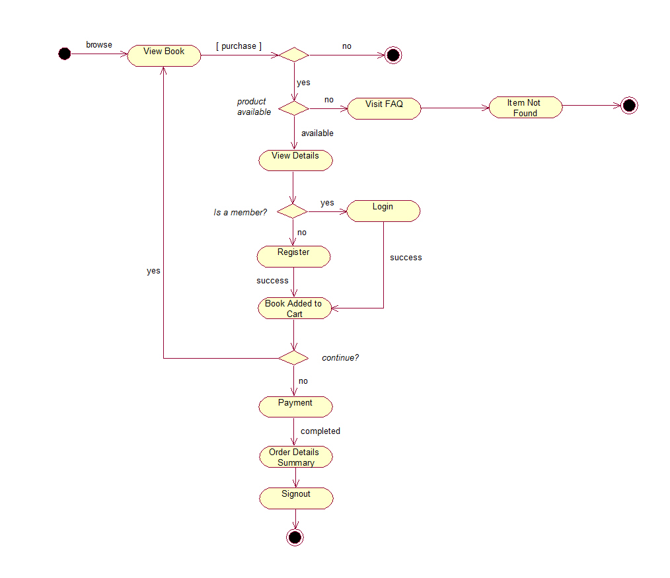
ACTIVITY DIAGRAM:

Slide 7
REQUIREMENTS
Software Requirements:
Operating System : Windows
Application Server : Apache Tomcat5.0/6.X
Front-End design : HTML, CSS
Back-End design : Servlets
Database : Oracle 10g
Database Connectivity : JDBC
Minimum Hardware Requirements:
Processor : Pentium - IV
RAM : 1GB
Hard disk : 20GB

Slide 8
SCOPE OF THE PROPOSED SYSTEM
Our web portal is a one step solution for all engineering students.
Instead of carrying large text books they can access them in their devices.
Library in a single web based portal.
Hands-on IDE for CS students for coding.
Aptitude books for placement preparation.

Slide 9
CONCLUSION
It is very useful for engineering students.
It provides first-hand information in the form of textbooks.
It provides free access to all prescribed standard textbooks.
It is useful for faculty and also for easy accessing of books.
One step solution to all problems faced by engineering students.
Reduces arrears of engineering students.

Slide 10
THANK YOU
Any Queries???
Please Feel Free To Ask.

